Slide 1



RUBIK CUBE SOLVER
AEROHACK DESIGN CHALLENGE

Slide 2

Problem Understanding
•Solve any valid 3x3 Rubik’s Cube scramble.
•Replicate real-world solving logic (not brute-force).
•Challenges: modeling cube state, applying face turns, building accurate layer-by-layer solution.

Slide 3

APPROACH OVERVIEW
•Step-by-step solver with 6 logical phases:
•1. White Cross → 2. White Corners → 3. Middle Layer
•4. Yellow Cross → 5. Yellow Corners → 6. Final Edge Permutation
•Each step is deterministic and reproducible.

Slide 4
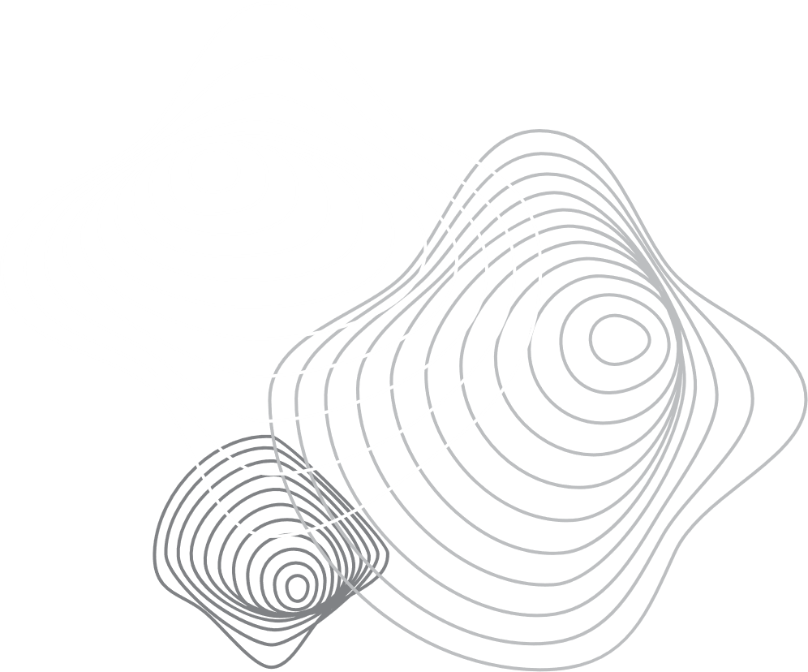

DATA STRUCTURES USED
•RubikCube class: 6 faces (U, D, L, R, F, B), each a 3x3 list.
•All cube states updated with `.apply_moves()` method.
•Moves like U, R', D2 rotate corresponding face and adjust neighbors.
•Solution tracked in a move list and shown in UI.

Slide 5

ALGORITHM EFFICIENCY
•Non-random, deterministic logic per phase.
•Not BFS or IDA*: prioritizes clarity over shortest path.
•Average 100–150 moves depending on scramble complexity.
•Good tradeoff between performance and understandability.

Slide 6

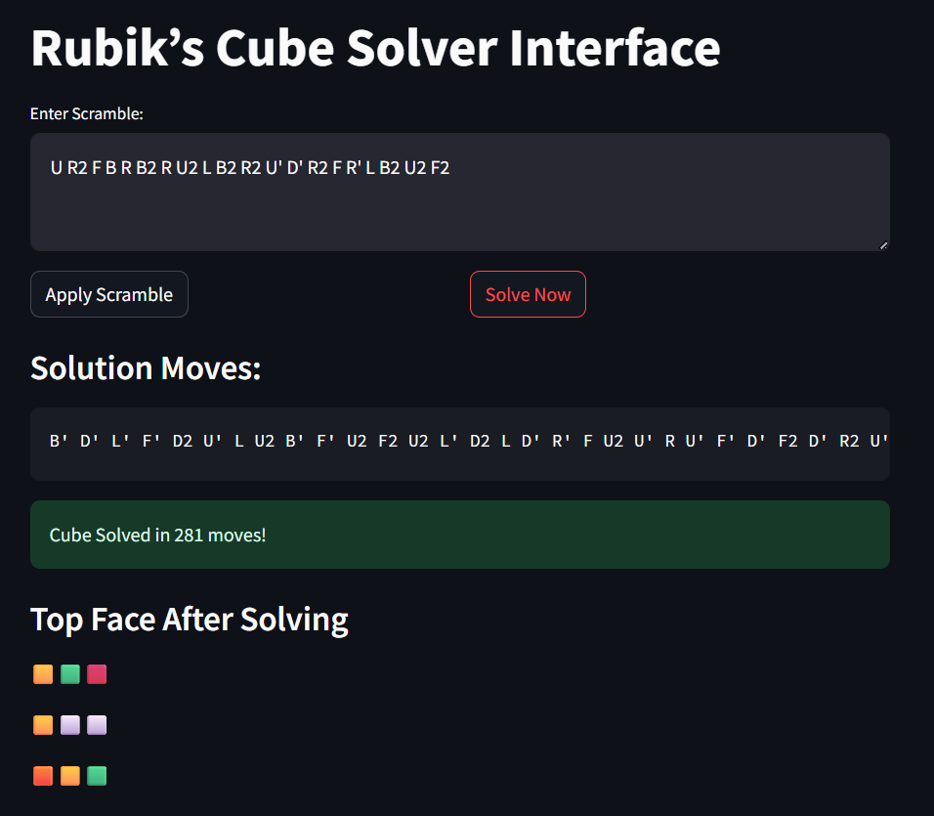
UI + OUTPUT DEMO

Slide 7
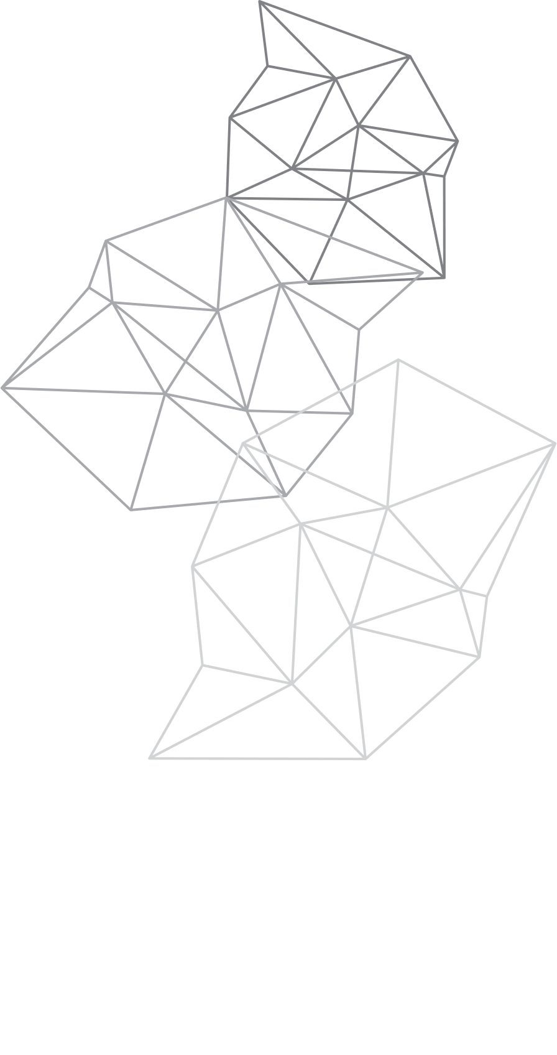
FINAL SUMMARY
•Clean and complete 3x3 Rubik's Cube solver.
•Streamlit UI: no extra setup, runs in browser.
•Modular code structure with room to expand to 4x4 or add 3D view.
•Ideal for demos, interviews, or further research.

Slide 8
DELIVERABLES
•APP.PY, CUBE.PY, SOLVER.PY, UTILS.PY
•README.MD AND REQUIREMENTS.TXT
•PROJECT SCREENSHOT AND THIS PRESENTATION

Slide 9
THANK YOU

